Slide 1


The World Leader in High-Performance Signal Processing Solutions
ADP199 ESD 100 UNITS EVALUATION using
3M Part # 3M100701

Slide 2
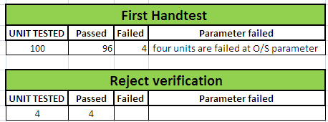
100 Units hand test results
Four units are failed at O/S parameters during first test, but those units passed during verification
RAW DATA :

